Slide 1
Biospecimen Collection
and the
NRG Oncology Biospecimen Banks
(NRG-BB)
Lisa Beaverson, Sandy DeVries,
Melanie Finnigan, Heather Lankes, Sheralee Miller
NRG Oncology Semiannual Meeting
July 15, 2016

Slide 2
NRG Oncology Biospecimen Banks
Gynecologic
Brain, Head & Neck, Non-Colorectal GI, GU, and Lung
Pittsburgh, PA
Columbus, OH
San Francisco, CA
Breast and GI Colorectal
Houston, TX
Breast and GI Colorectal
Serum Bank

Slide 3
Translational Research
“Translational research means different things to different people, but it seems important to almost everyone.”
Steven H Woolf, MD, MPH; JAMA 2008

Slide 4
Translational Research
A common phrase associated with translational research is “bench to bedside” – translating laboratory findings into patient care.
The NCI Translational Research Working Group definition:
“Translational research transforms scientific discoveries arising from laboratory, clinical, or population studies into clinical applications to reduce cancer incidence, morbidity, and mortality.”

Slide 5
Translational Research - The Big Picture
Participating Site
NRG Oncology BB/ SDMC
Investigator/NRG Oncology SDMC
Patient enrolls on protocol and consents to biospecimen collection
Required biospecimens are collected and shipped to the appropriate NRG Oncology Biospecimen Bank with the appropriate forms
Biospecimens are received, quality and condition are assessed, biospecimens are banked
NRG Oncology consults with sites if any issues arise
Biospecimens are distributed to approved investigators for testing
Laboratory testing is completed
Testing results are analyzed and interpreted
Results are disseminated to the scientific and medical communities – ultimately, this may affect patient care and/or future trial design

Slide 6
Biospecimen Quality
High quality biospecimens yield high quality results.
Collection and processing instructions in protocols or supporting materials are designed to help you provide high quality biospecimens.
Most biospecimens are stored for many years prior to use for research.

Slide 7
Locating Biospecimen Information for NRG protocols
Section 10.0/11.0 PATHOLOGY, BIOMARKER, CORRELATIVE, AND SPECIAL STUDIES
This section includes information on mandatory and banking biospecimen submissions including specimen type, collection time points, collection procedures, and shipping information. This section can also describe the use of biospecimens and the rationale for the testing performed, if known.
Protocol biospecimen specific processing/shipping information can be found:
CTSU.org website: For example, NRG-BR003 Pathology and Correlative Science Instructions located under Education and Promotion Materials on CTSU website.
Appendices of Protocol: For example, GYN studies, NRG-BN001
In Kits
Generic processing instructions on bank websites:
https://www.rtog.org/LinkClick.aspx?fileticket=1SFlEVxSui4%3d&tabid=281

Slide 8
Biospecimen Types Collected
FFPE Tissue | Frozen Tissue | Blood Biospecimens | Other
Blocks Unstained Slides Stained Slides Scrolls Cores Punch cores | Snap Frozen Cores in OCT CSF & Bone Marrow | Whole blood Peripheral Blood Mononuclear Cells (PBMC) Plasma Serum Buffy Coat | Cores in RNAlater Buccal Saliva Urine Cervical Cells Peritoneal Fluid Peritoneal Wash

Slide 9
Biospecimen Labeling Requirements
All biospecimens shipped to NRG-BB must be labeled with:
Protocol Number (ex: NRG BR001)
Specimen Type or Specimen Code
Collection Date
Bank ID (GY only) or Patient ID (all other studies)
Tissue biospecimens should also be labeled with:
Surgical Pathology Accession Number
Block Number (FFPE only)

Slide 10
Blocks Versus Slides
Biomarkers
Fresh cut slides produce optimal results
Slides that are not fresh cut can cause erroneous results
DNA/RNA
Blocks can be punched or fresh cut
Slides require microdissection, fewer cases will yield usable DNA or RNA, require a higher tumor content and, many more slides are needed
Tissue Micro Arrays
Cannot be created unless blocks are submitted

Slide 11
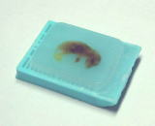
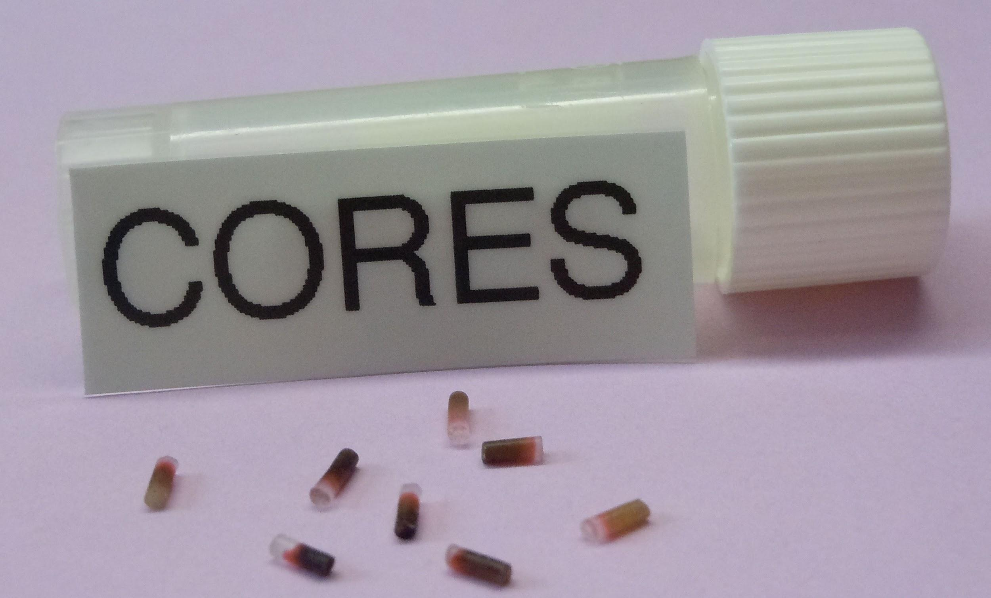
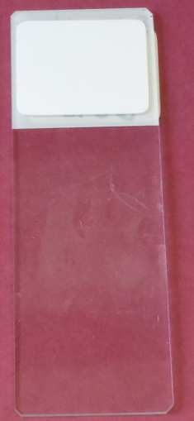
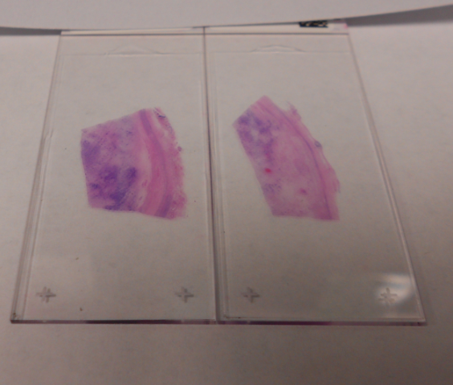
Biospecimens Examples of FFPE
Block
Unstained Slide
Unstained Slide
H&E Stained Slides

Slide 12
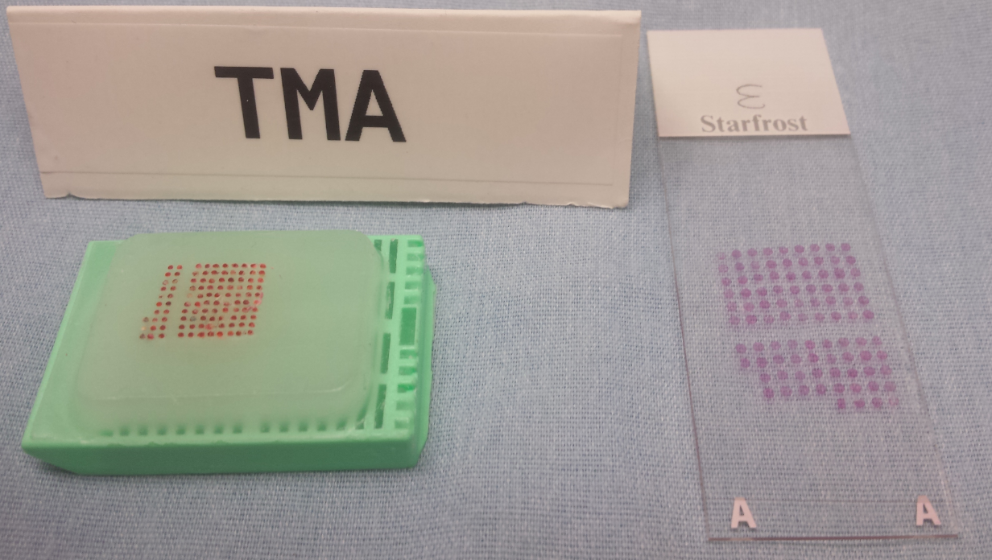
Biospecimens FFPE - Tissue Microarray
A tissue microarray (TMA) contains tissue cores from many different cases.
Sections from a TMA block can be cut and mounted on a slide, allowing the analysis of multiple biospecimens at the same time.

Slide 13
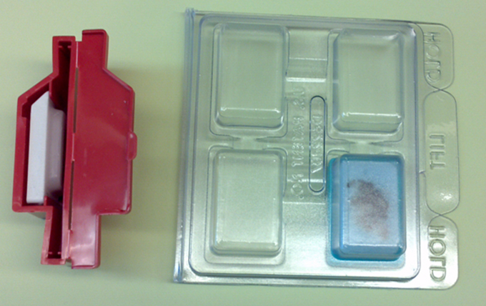
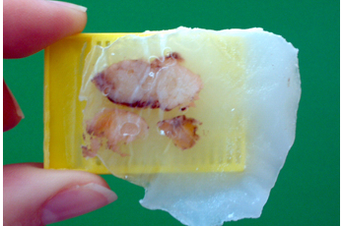
Biospecimens FFPE - Blocks
How do I ship blocks?
Blocks should be shipped in a special block holder, if possible
NEVER wrap blocks in gauze, bubble wrap, or a plastic bag.
Ship Blocks in boxes or padded envelopes with Cold Packs to prevent paraffin wax melting. Do not ship in flat or cardboard envelopes.
Examples of block holders
A block with melted paraffin

Slide 14
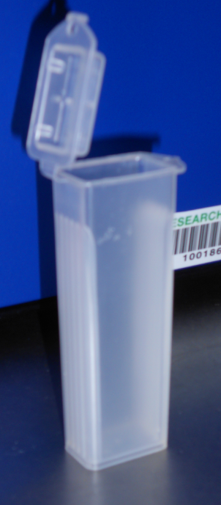
Biospecimens FFPE - Slides
How do I ship slides?
Slides need to be packaged very carefully so that they do not break during shipment.
Verify slides are dry. Never ship wet slides!
Place slides in hard-sided plastic slide holder. (See photo.)
Don’t use Cardboard Slide Flats!
Secure slides with cotton or soft paper or Kim wipe, or bubble wrap under the lid.
Tape lid shut.
Shake gently- If you hear them Shaking they will be Breaking.
Wrap the slide cartridge in bubble wrap or mail in a padded envelope or in a box. Do not ship in flat or cardboard envelopes.
Hard-sided Slide Holder
Plastic Slide Holder

Slide 15
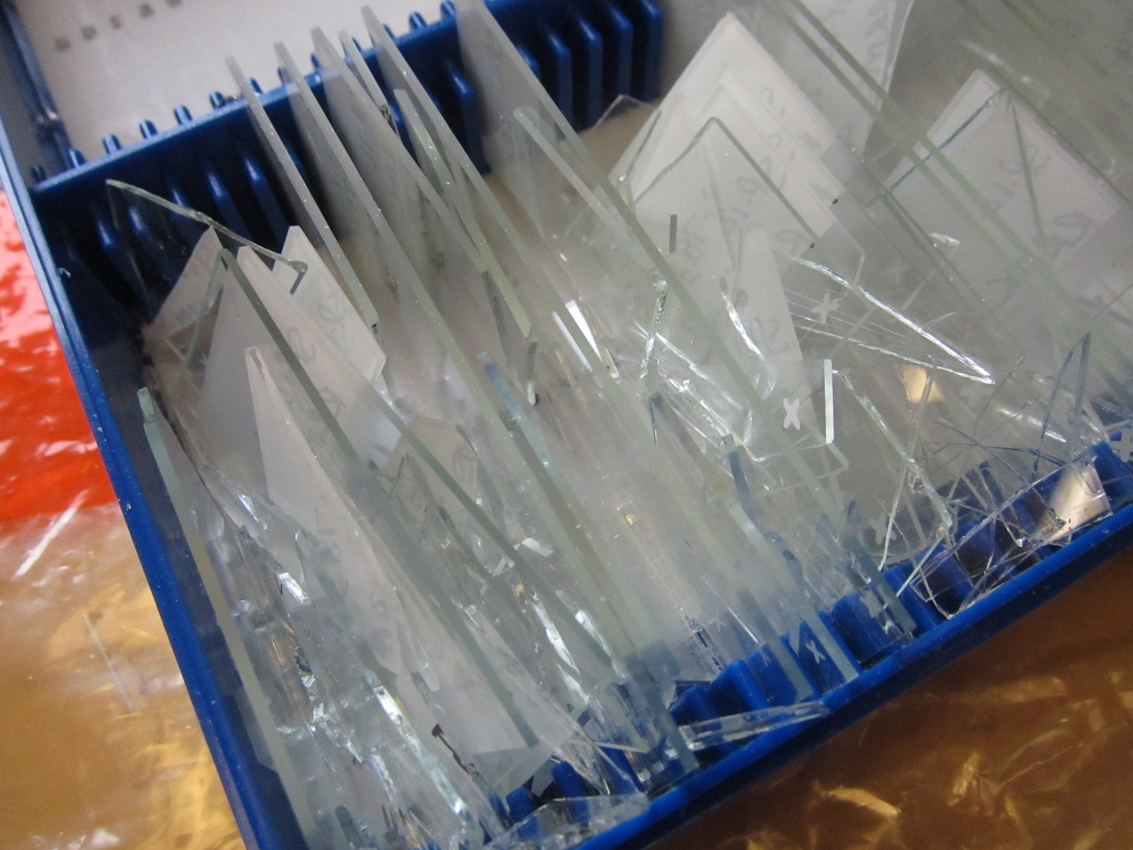
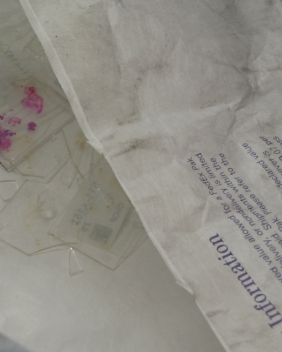
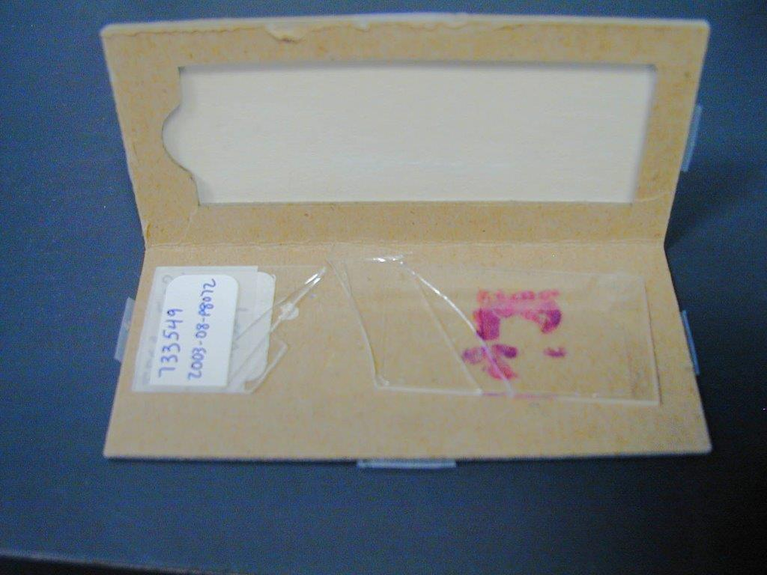
Improperly Packaged Slides
These slides were not packaged appropriately and broke in transit.

Slide 16
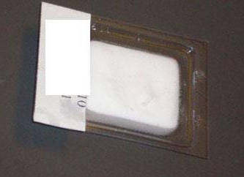
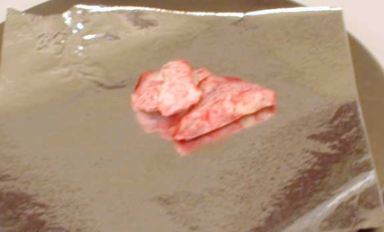
Biospecimens Frozen Tissue
OCT embedded frozen tissue
Tissue ready to be snap frozen in foil

Slide 17
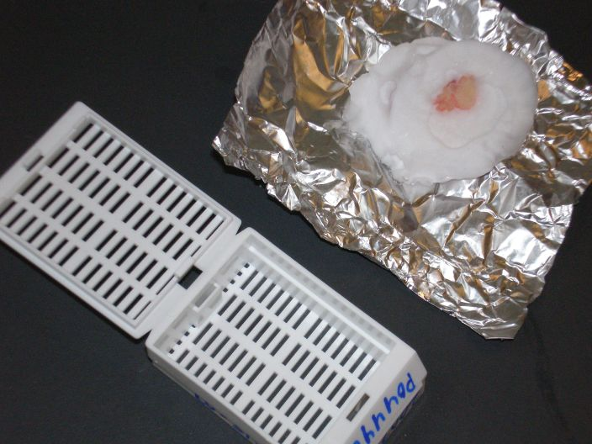
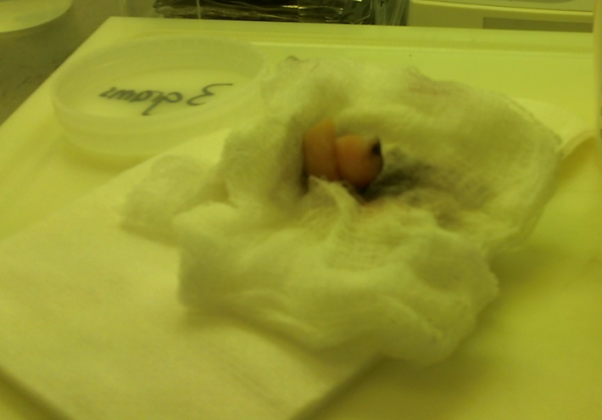
Biospecimens Example: Unusable Frozen Tissue
Tissue is not completely covered with OCT compound.
The biospecimen is too large to fit into cassette for banking.
The tissue was wrapped in gauze, which is sticking to the tissue.
The tissue was not frozen or placed in media to preserve it.

Slide 18
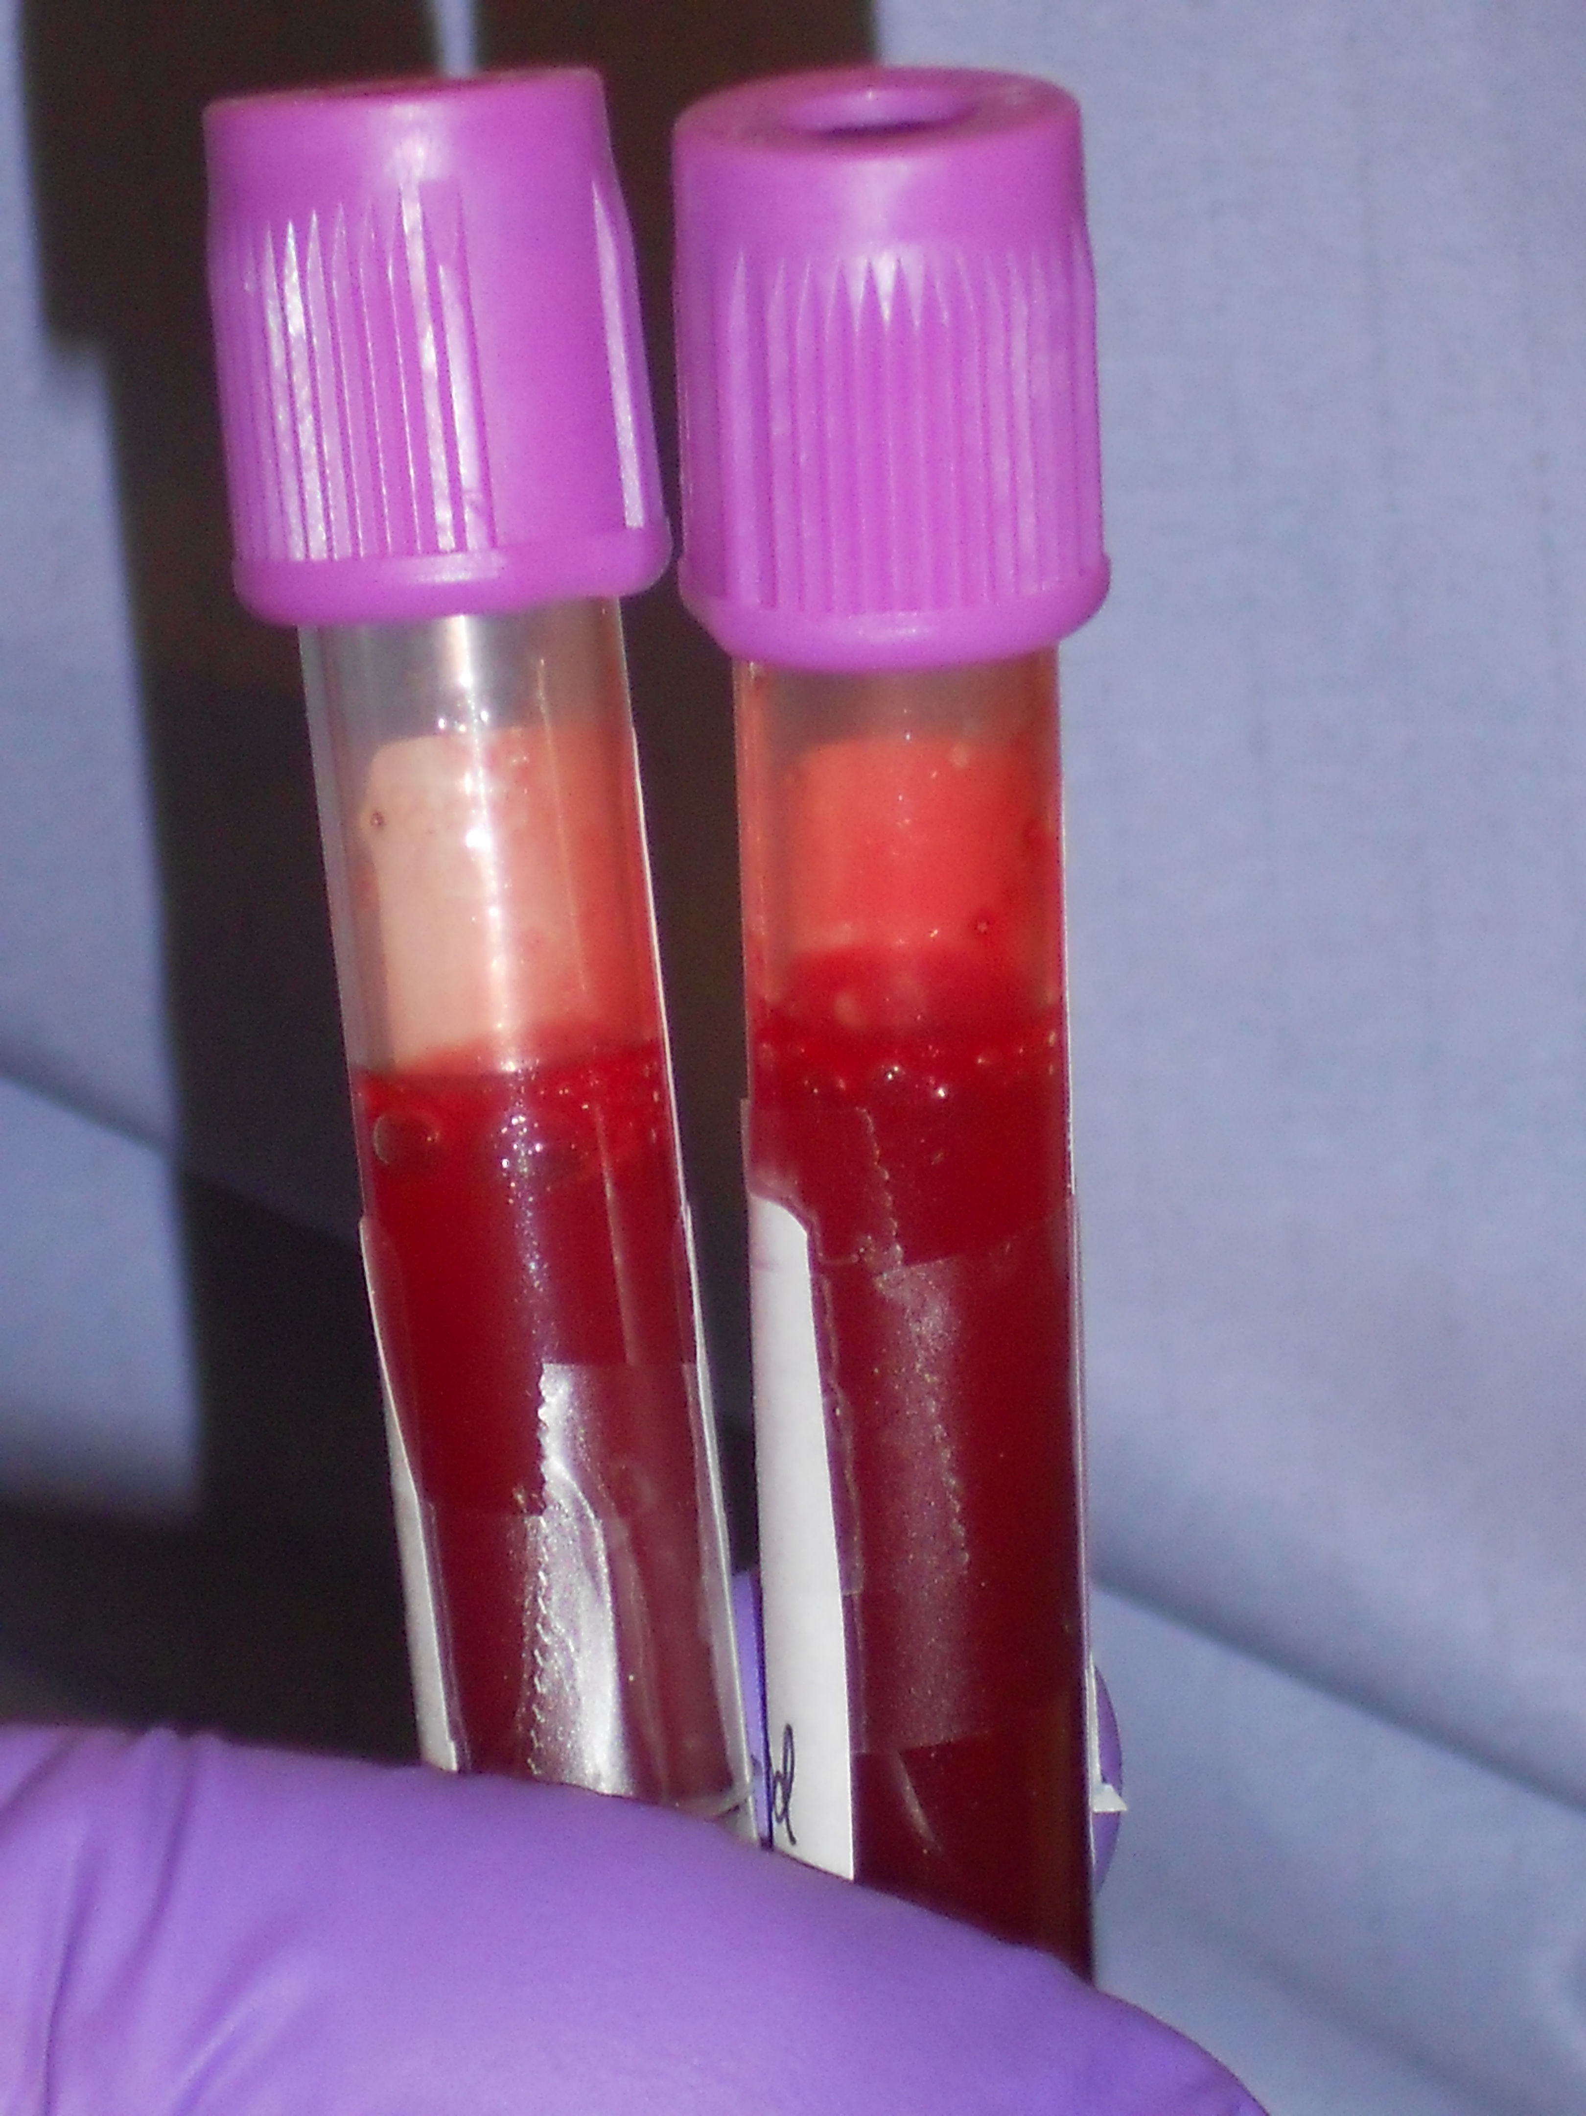
Biospecimens Blood
Collection and processing of blood varies by protocol:
Spin for plasma (serum- if collected in red top), aliquot into cryovials, and ship frozen
Ship ambient in collection tube for processing at bank
Aliquot into cryovials and freeze before shipment
Whole blood collected in plastic EDTA tubes

Slide 19
Biospecimens Blood Collection Tube Types
Purple top tubes contain an additive, EDTA, which is an anticoagulant, but differs from heparin in its effect on nucleic acids.
Blood collected in purple top tubes can be centrifuged into red cells (bottom layer), white cells or buffy coats/PBMCs (middle layer), and plasma (top layer).

Slide 20
Biospecimens Blood Collection Tube Types
Green top tubes contain an additive, Heparin, which is an anticoagulant. Heparin differs from EDTA in its downstream applications.
Blood collected in green top tubes can be centrifuged into red cells (bottom layer), white cells or buffy coats/PBMCs (middle layer) that are used for DNA isolation, and plasma (top layer).

Slide 21
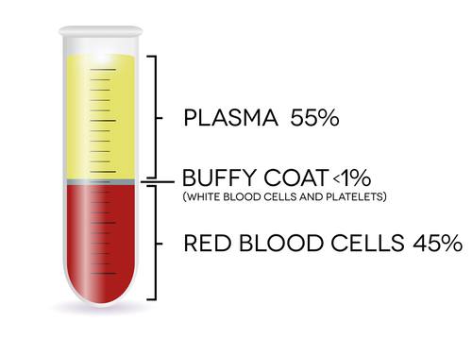
Biospecimens
Purple EDTA Tube After Spinning

Slide 22
Biospecimens Blood Collection Tube Types
Red top tubes do not contain additives.
Blood collected in red top tubes can be centrifuged into white and red cells (bottom layer) and serum (top layer).

Slide 23
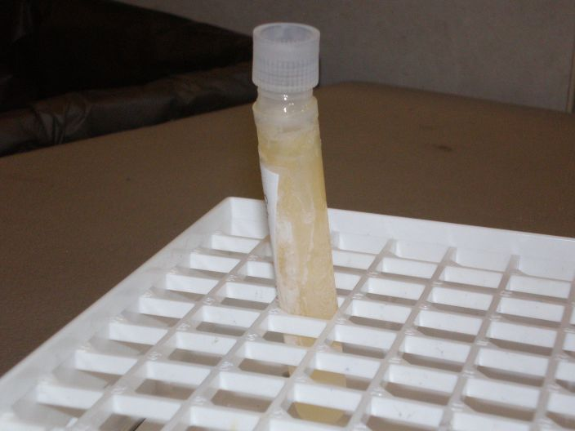
Biospecimens Example: Unusable Liquid Biospecimen
The tube was filled with too much liquid.
Remember that liquid expands when it freezes!

Slide 24
Biospecimen Storage
Temperature is critical in maintaining biospecimen quality.
Frozen equals -70°C or colder.*
Liquid nitrogen vapor averages between -170°C and -190°C.
Refrigeration equals 4°C (standard refrigerator temp).
Use of Dry Ice is a short term option if you do not have access to a -70°C or -80°C freezer (ship within 24 hours).
*-20°C is normal setting for a regular freezer. DO NOT USE unless you do not have access to -70°C or dry ice. Biospecimens stored at -20°C should be shipped within 24 hours of collection when possible. Note storage method on submission form.

Slide 25
Biospecimen Storage
If a biospecimen is frozen, then it should remain frozen.
Thawing and refreezing biospecimens negatively affects biospecimen quality.
Frozen biospecimens should be shipped on dry ice, NOT with an ice pack, in order to maintain biospecimen quality.

Slide 26
Frozen Biospecimen Shipment
Ship frozen biospecimens with more dry ice than biospecimens.
Dry ice changes from a solid to a gas at a rate of 5-10 lbs. every 24 hours during shipment.
Do not ship frozen biospecimens on Thursday or Friday, wait until Monday.
If the shipment is delayed over a weekend then it will probably arrive at the bank thawed.

Slide 27
Biospecimen Shipment
Remember when shipping, that even if weather is fine where you are, the biospecimens are traveling from
your city to a FedEx Hub to the bank
Map of FedEx Hubs

Slide 28
Biospecimen Shipment Tips
Ship via FedEx Priority Overnight.
Using First Overnight will delay receipt
Sign up for FedEx Service Alerts to receive information about weather, natural disasters and other events that might delay delivery:
http://www.fedex.com/us/servicealerts/

Slide 29
Biospecimen Handling
Always use Universal Precautions when handling biospecimens.
Please refer to your institution’s guidelines for more information on Universal Precautions and the handling of biospecimens.

Slide 30
Shipping Regulations
Contact your institution’s Safety Department to learn about shipping regulations and to obtain training.
You must complete training prior to shipping biospecimens.
Ultimately, it is the shipper’s responsibility to use the correct packaging methods when shipping biospecimens.

Slide 31
NRG-BB Bank Contact Info
Pittsburgh: Melanie Finnigan
Email: NRGbiobankPGH@NRGOncology.org
Phone: 412-697-6611 San Francisco: Sandy DeVries Email: NRGBB@ucsf.edu
Phone: 415-476-7864 (Bank #) Columbus: Lisa DeNero
Email: BPCBank@nationwidechildrens.org
Phone: 866-464-2262

Slide 32
Additional Contacts and Information
See Handouts

Slide 33
QUESTIONS?????

